Slide 1
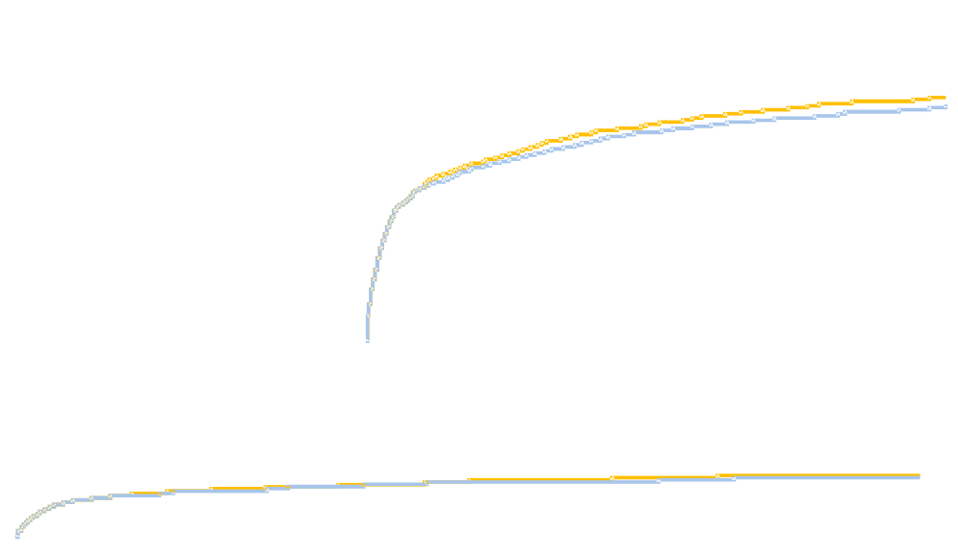
PLATO showed no increase in the rate of overall major bleeding but there was an increase in the rate of non–
CABG TIMI major bleeding, similar to TRITON
100
15
90
Ticagrelor
80
10
70
Clopidogrel
60
Cumulative incidence
of major bleeding (%)
5
50
40
0
30
0 2 4 6 8 10 12
20
10
p=0.43
0
0 2 4 6 8 10 12
Months
No. at risk
Ticagrelor 9235 7246 6826 6545 5129 3783 3433
Clopidogrel 9186 7305 6930 6670 5209 3841 3479
Non-CABG TIMI major bleeding 2.8% ticagrelor vs. 2.2% clopidogrel, N=0.03
Wallentin L, et al. NEJM 2009;361:1045-57

